Slide 1

Inside Sales Mastery Series
Effective use of Zymewire
Session# 3
Hosted by: Lead Optimization Team (Marketing Operations)
21 November 2024

Slide 2
Table of Contents
Introduction to Zymewire
Account activation and Navigation
Setting up territory
Creating Feeds
Company Dashboards
Collaboration in Zymewire
Overview of Zoudini
Open Q&A/Discussion

Slide 3
Welcome to Inside Sales Mastery Series
About this Series
This training series is designed specifically for our inside sales team to enhance your skills in several key areas.
Gain expertise in essential tools and techniques.
Learn best practices to streamline your workflow.
Ensure everyone is on the same page with the latest industry standards and practices.
Ask a question – Pre-submit your questions here or ask during the office hours
Learn how to leverage IQVIA’s marketing systems and processes most effectively
Action: Sign up here, if you need to be added to the outlook invite
Reminder: Save your questions for the end or enter in the chat. We will address as many as we can!

Slide 4
Introduction and Capabilities of Zymewire

Slide 5
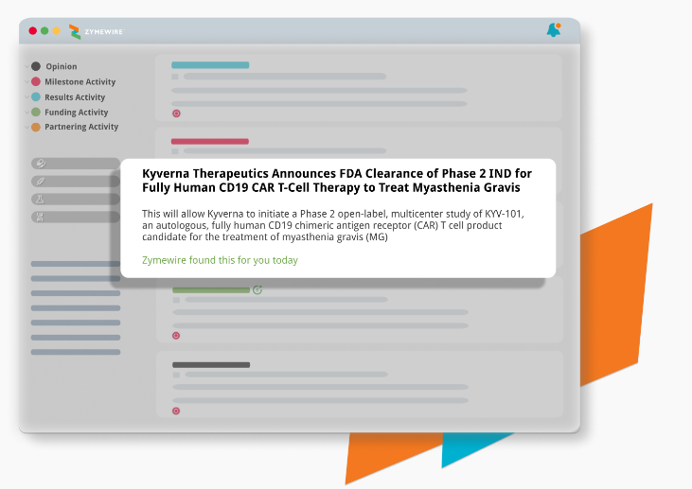
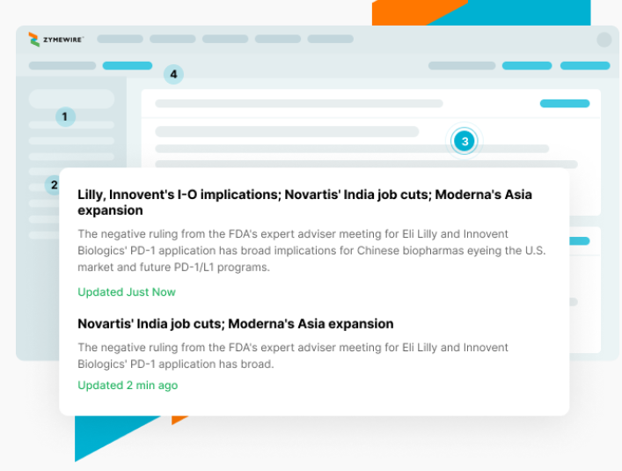
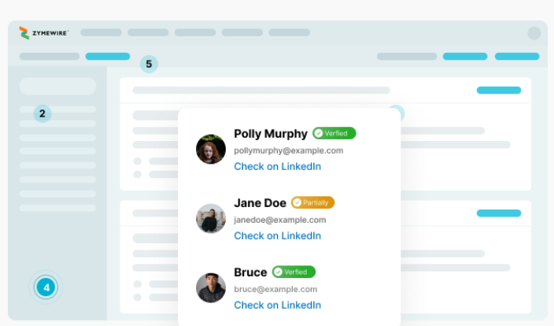
Introduction to Zymewire
Sales intelligence platform for biotech and pharmaceutical industries
It helps sales professionals identify and prioritize potential leads by providing actionable insights and data.
Generate new prospects and identify high-priority targets in your pipeline
Get updates about companies you care about, including stealth biotech companies and early-stage future plans
Segment company list by over 120 data points to find the most relevant leads

Slide 6
Zymewire Capabilities
Prospecting and Lead Generation: Zymewire helps sales professionals generate new prospects and identify high-priority targets in pipeline. It provides real-time updates about companies, including stealth biotech companies that are not yet publicly visible
Actionable Sales Intelligence: The platform offers over 120 data points to segment company lists, such as therapeutic focus, drug delivery method, geographic region, cumulative funding, and employee count. This helps in prioritizing targets and tailoring outreach efforts.
Verified Contact Information: Zymewire reveals verified contact information for decision-makers, enabling sales teams to reach out with specific, individualized messaging
Early-Stage Company Identification: It tracks early-stage companies, fundraising events, and preclinical activities, allowing users to engage with prospects before competitors do
Integration with Salesforce: Zymewire integrates seamlessly with Salesforce, helping sales teams manage their pipeline and track interactions more efficiently

Slide 7
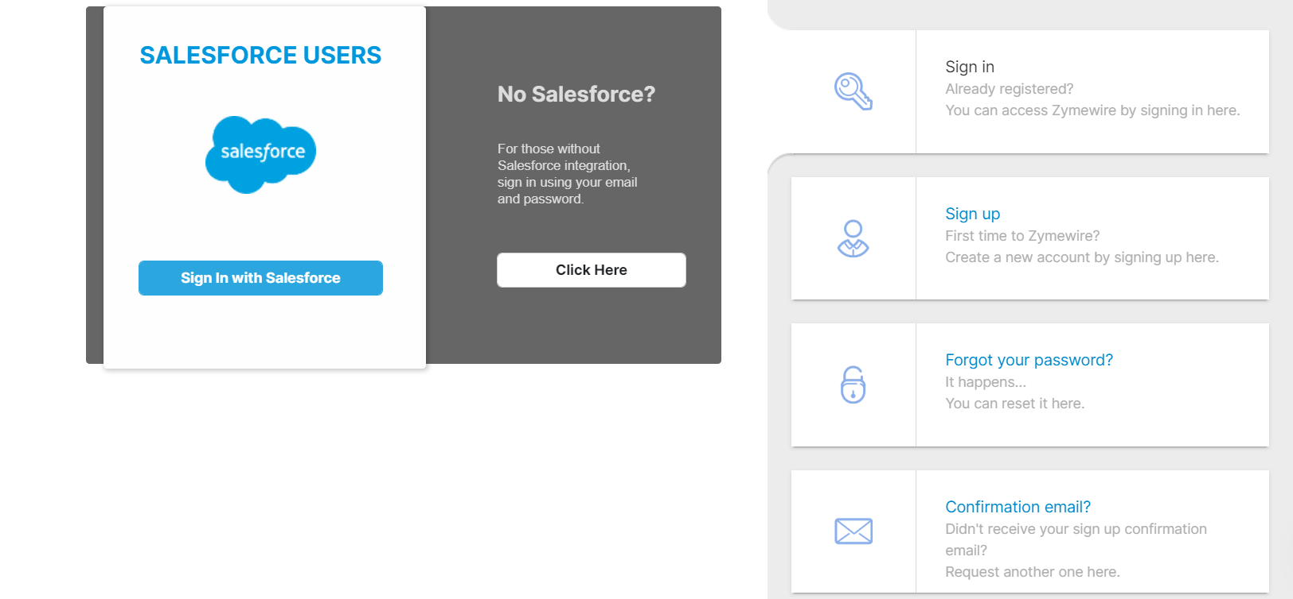
Account activation and Navigation
Open https://www.zymewire.com/

Slide 8
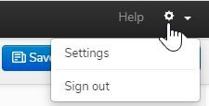
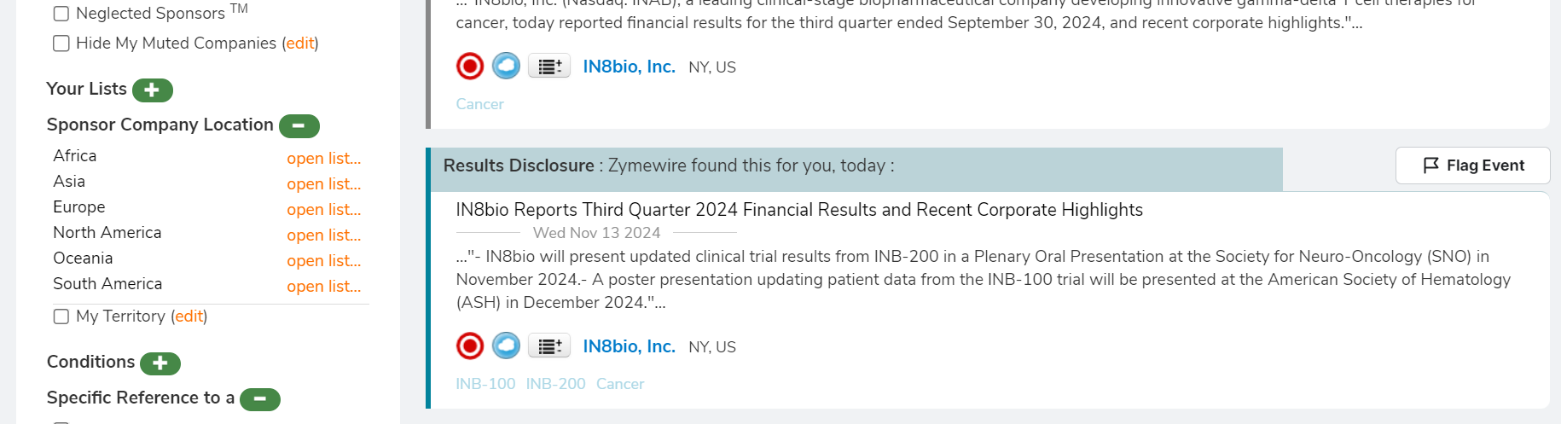
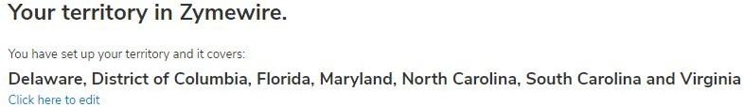
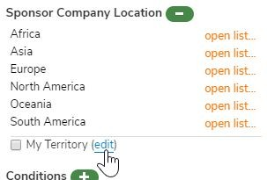
Setting up territory
click on the settings wheel to create or edit your settings
Or Under Sponsor Company Location, select Edit beside My Territory
Apply your territory to searches by clicking on the “My Territory” button

Slide 9
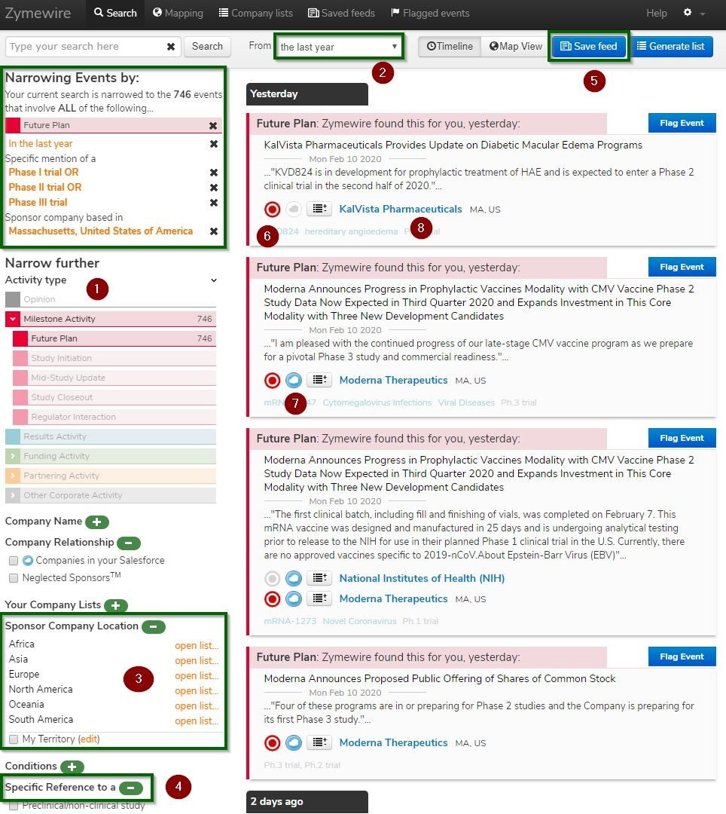
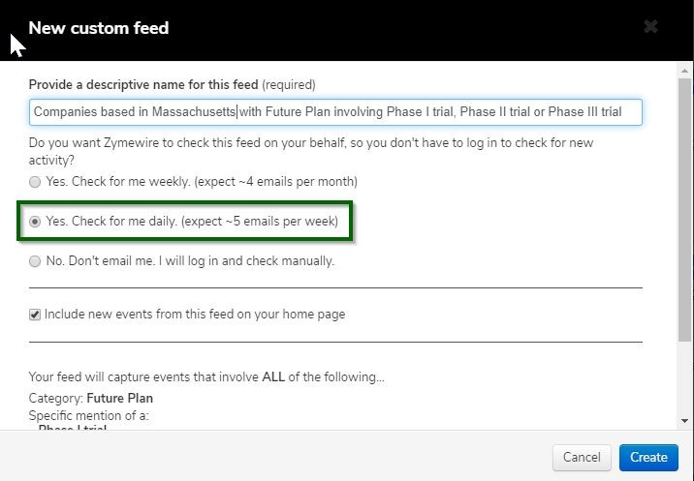
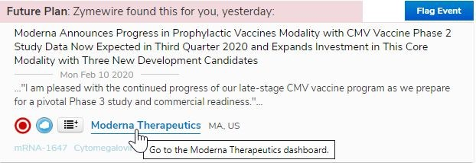
Creating Feeds
Daily or weekly email alerts based on your ideal prospect profile. Using event types and filters you can find specific targets, accounts, TA focus

Slide 10
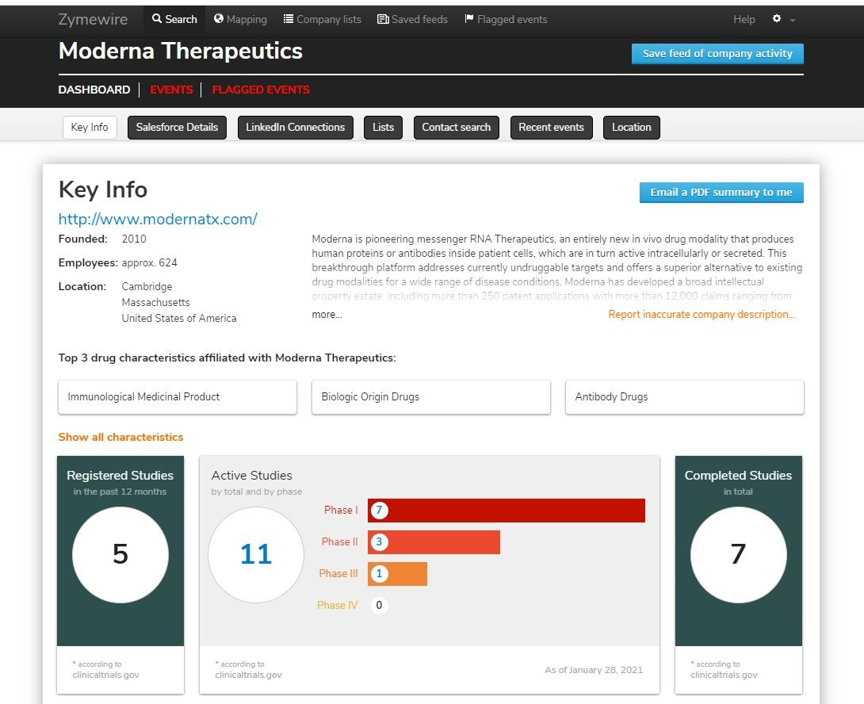
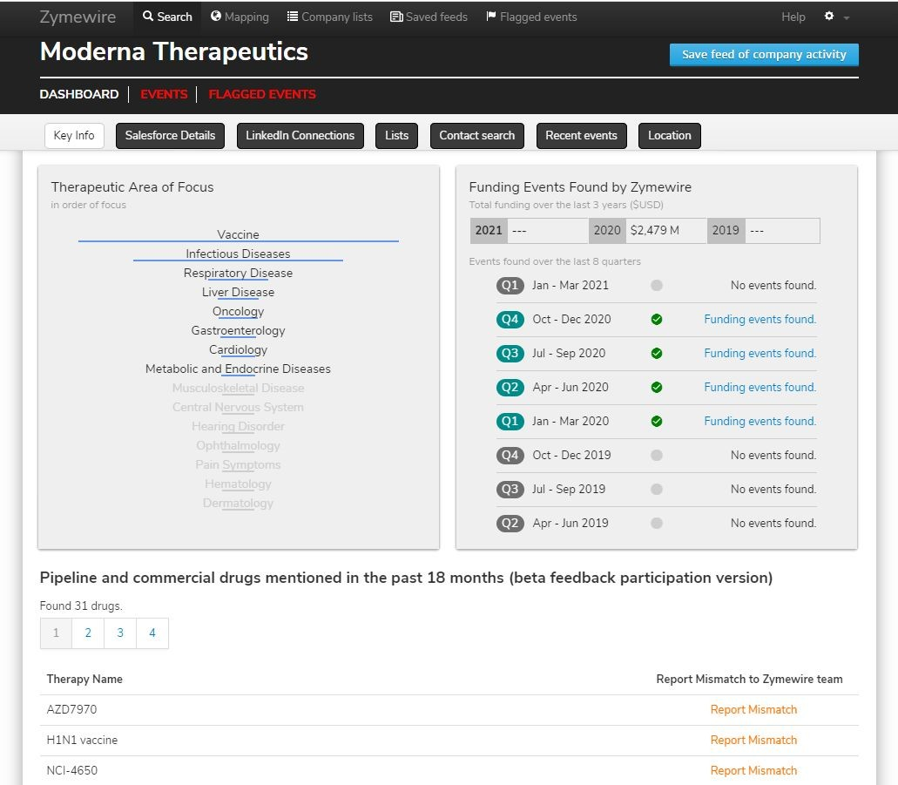
Company Dashboards
Here you can see, company URL, location of the HQ and a brief description. Below are stats from ct.gov to give you an idea on company maturity / and pipeline,TA,Funding

Slide 11
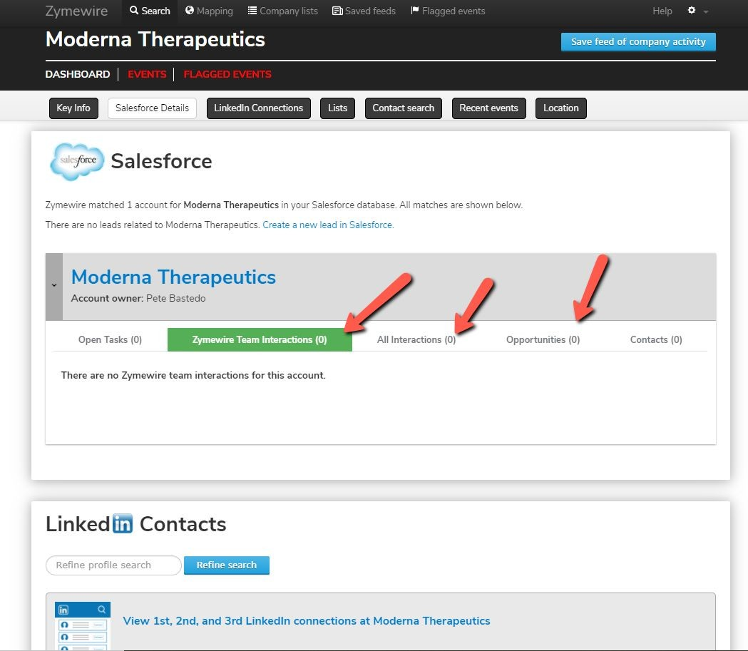
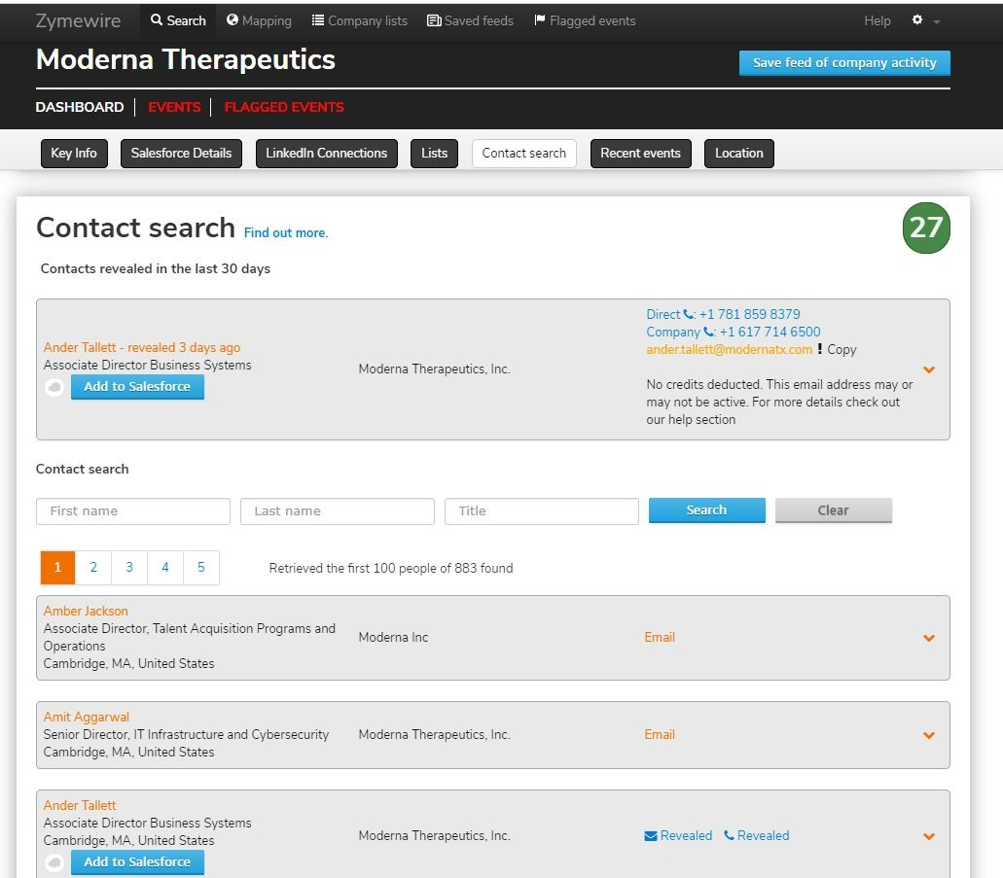
Company Dashboards
The Salesforce section provides visibility into account actions. Use LinkedIn to search for leads/contacts with keywords like CMC, Clinical Operations, or CSO/CMO. To find email or direct dials of a prospect. You can search by name & title or just scroll through the results

Slide 12
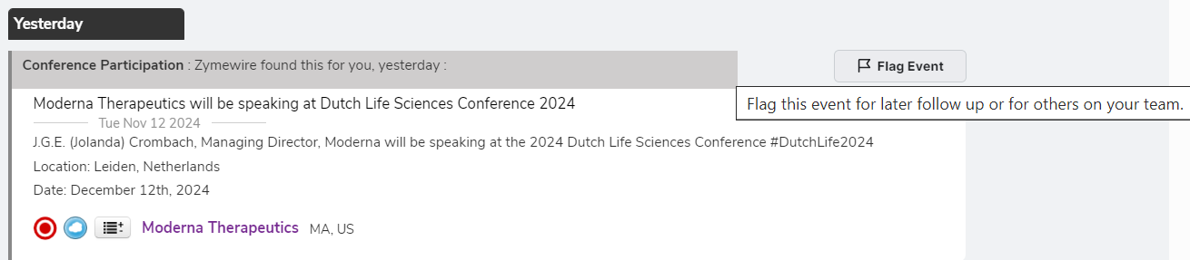
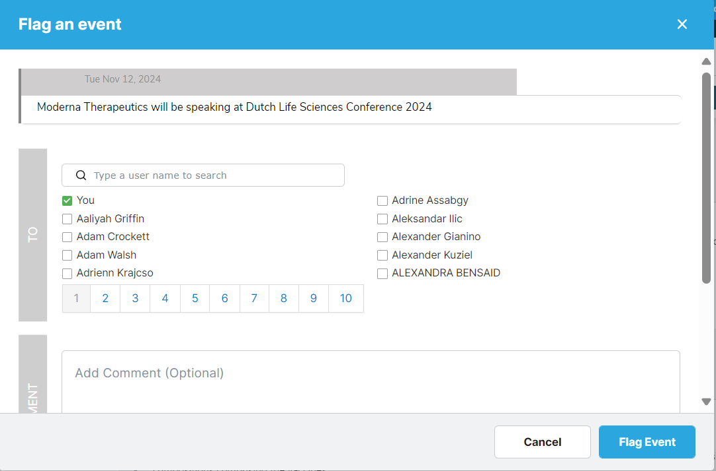
Collaboration in Zymewire
Save an activity to view later or share with a colleague

Slide 13
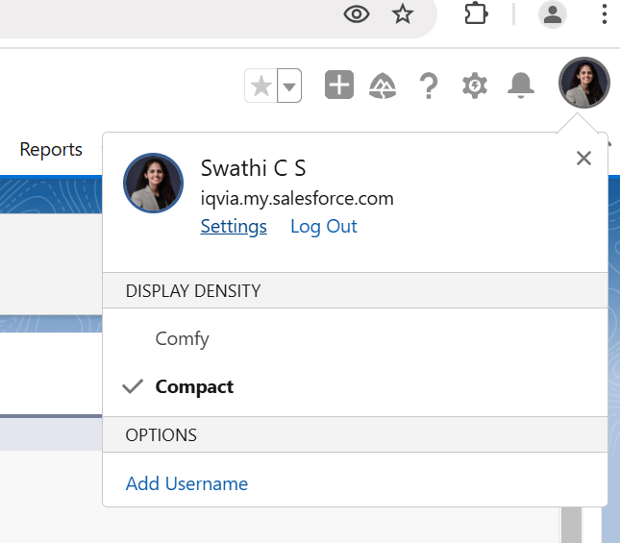
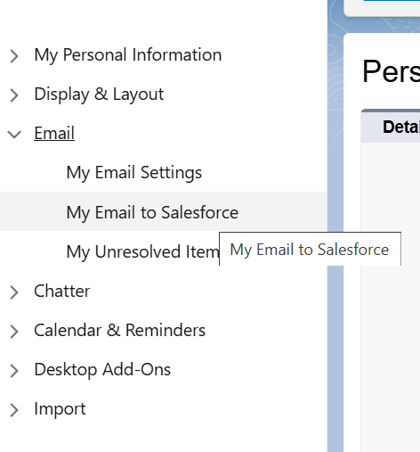
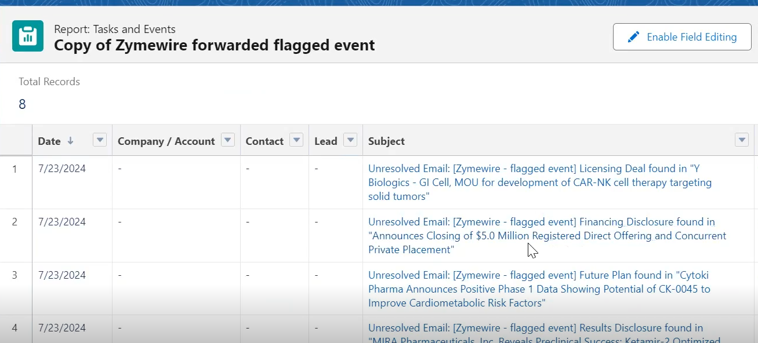
Zymewire Events into salesforce
Integrate Zymewire events into Salesforce to automatically create tasks

Slide 14
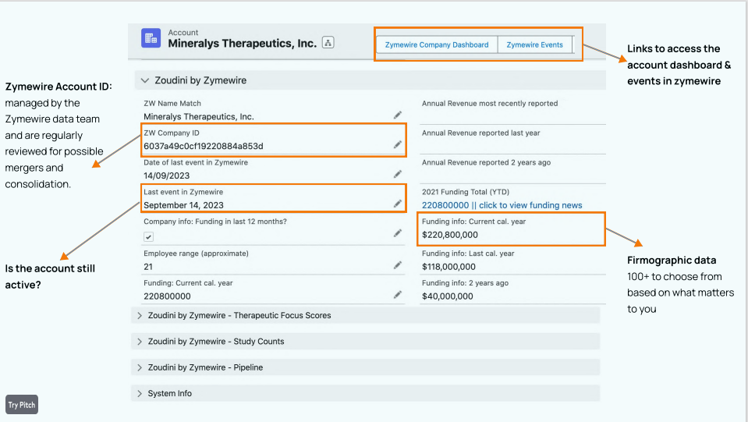
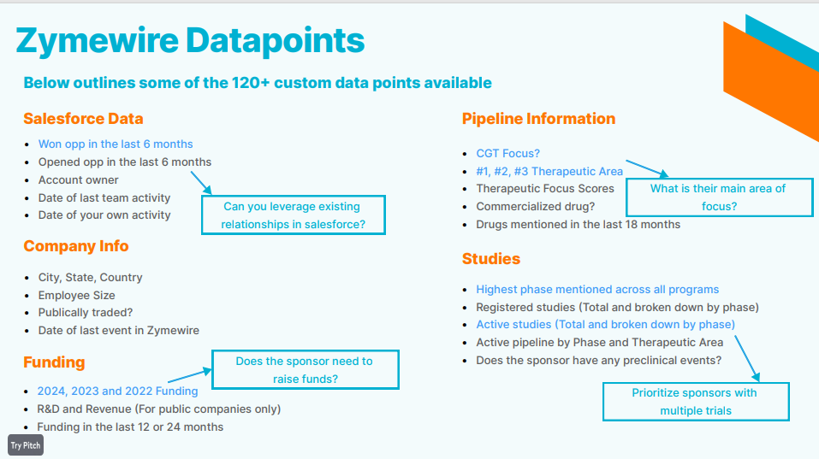
Zoudini
Enhance your salesforce records with up-to-date industry activity
Zoudini is an add-on for Zymewire, a platform designed to help biopharma service providers identify and connect with potential clients. Zoudini enhances Zymewire by automatically syncing its data directly to Salesforce, providing real-time industry updates and strategic territory planning.
Choose from over 120 + Zymewire data points to sync directly to salesforce
The update is triggered whenever a user logs in to Zymewire

Slide 15
Resources
Help | Zymewire
Zymewire - University Home (Gateway to mastering Zymewire)

Slide 16
Open Q&A/Discussion

Slide 17
Thank You!

